Slide 1
E-Learning Platform
CSE327.6
Faculty: Sarnali Basak(SLB)
Md Nafiz Al Mahmud
ID:2012241042
Mia Mahmudul Houque Shaon
ID: 2014314042
Asif Rahman
ID: 2012691042
Md Nazmul Islam Srabon
ID: 2021227042

Slide 2
Problem Statement
Students not being able to study online with verified teachers, through a simple but effective platform.
Our Proposed Solution
A simple E-Learning Web Application

Slide 3
Vision Statement
For: Student and teachers
Who: want a simple but effective education platform
The: Jibon-Juddho is an online web application
That: provides the ability for a student to study much more comfortably. As well as for the teachers to share their study materials with the students through a simple, intuitive interface.
Unlike: currently available systems our application is free.
Our: application will provide a simple but effective interface and will also make sure that the teachers are verified.
Jibon-Juddho is an online web application for students and teachers who want a simple but effective education platform. Unlike currently available platforms, Jibon-Juddho is a free platform . It will provide a simple, intuitive interface that will also make sure that the teachers are verified and make study much more comfortable.
.
Vision Statement

Slide 4

Student
Registration and login
Enrol and Drop
Edit profile
Delete account
Contents Title
Admin
Login
Add and Remove other types of users
Manage the whole system
Teacher
Registration and login
Upload course material
Edit Profile
Delete account

Slide 5
Functional Requirements
Students must register to enrol.
The system must allow the students to see the teacher’s profile.
Teachers must complete the verification process to register
Teachers should be able to publish their course materials
The student must be able to search for courses.
The system must allow the admin to add or remove students and
teachers account.

Slide 6
Non-functional Requirements
The users can request to remember their passwords.
Students can evaluate their respective course instructors.
Forgetful users can reset their password.
The system will provide technical support if requested.
The admin can look for teachers to offer new course.

Slide 7
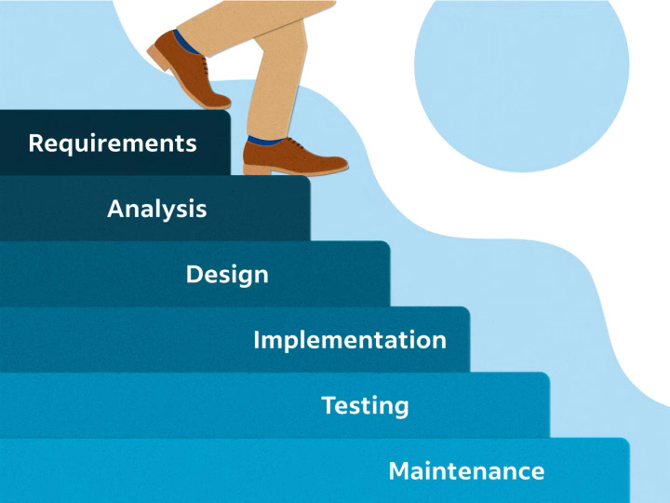
SDLC Model
The model we are using for our project is Waterfall Model.
Why?
 | 1
 | The requirements are precisely documented.
 | 2
 | The Project is short.
 | 3
 | Simple and easy to understand

Slide 8
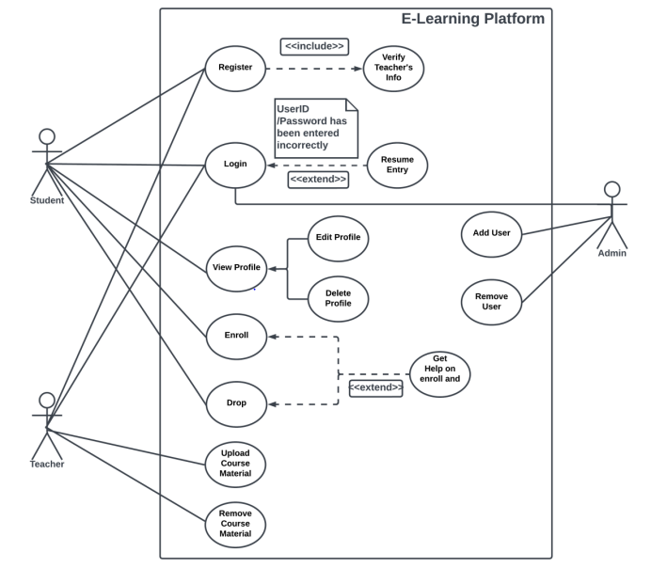
Use case Diagram

Slide 9
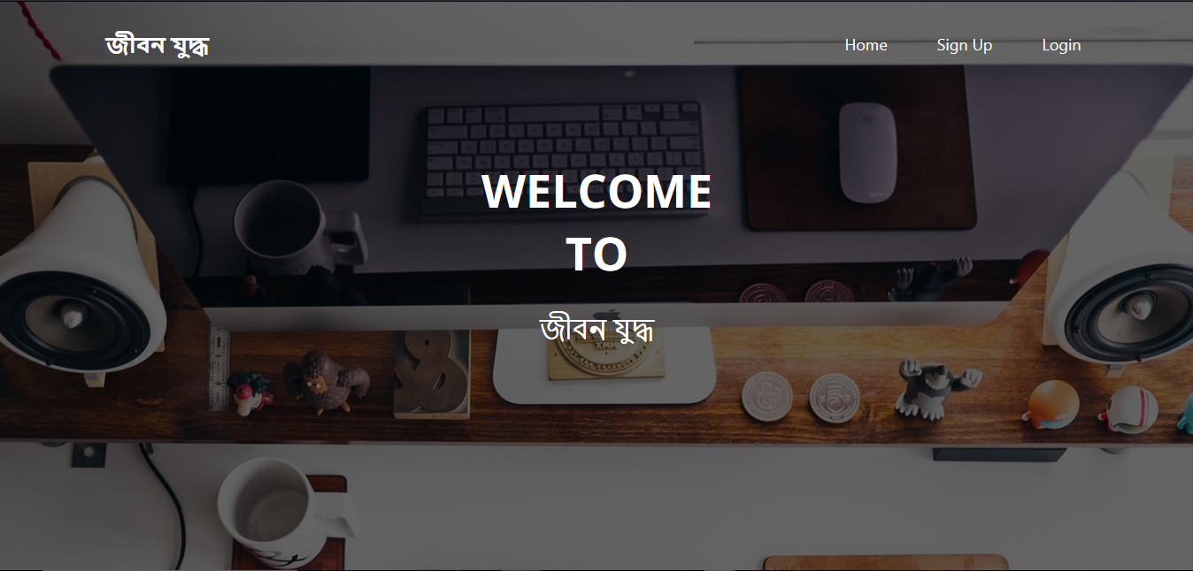

Slide 10
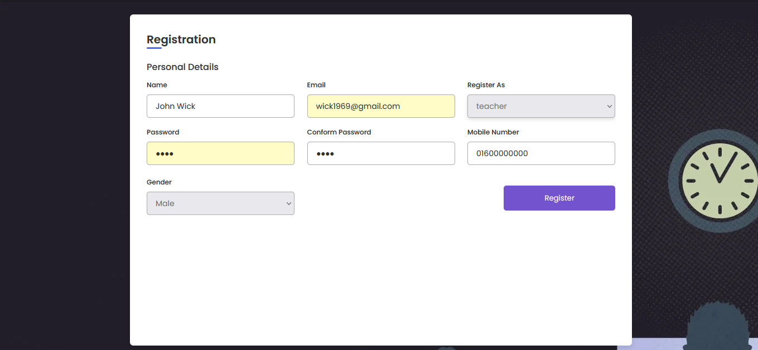

Slide 11
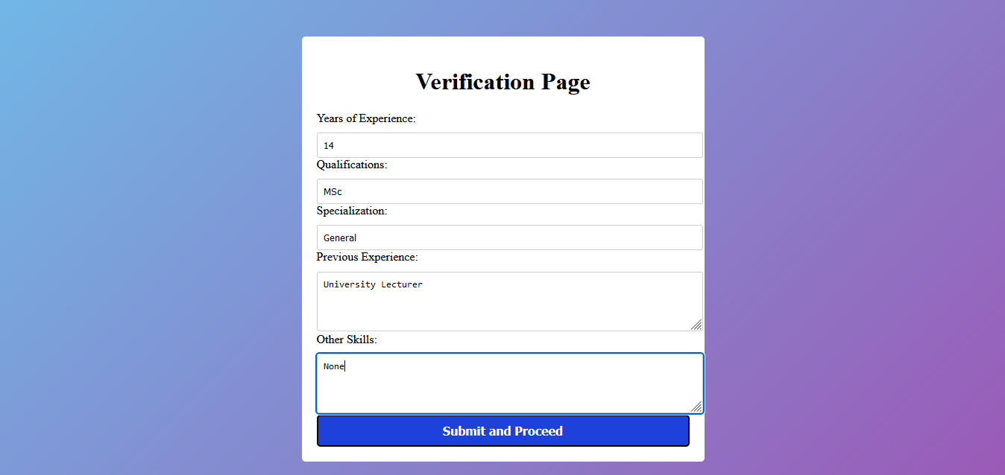

Slide 12
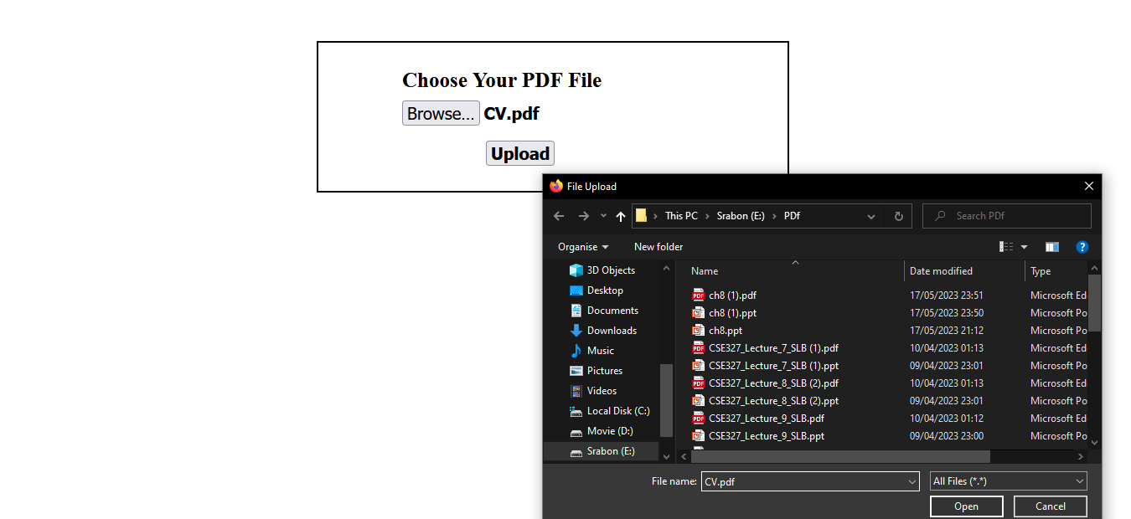

Slide 13
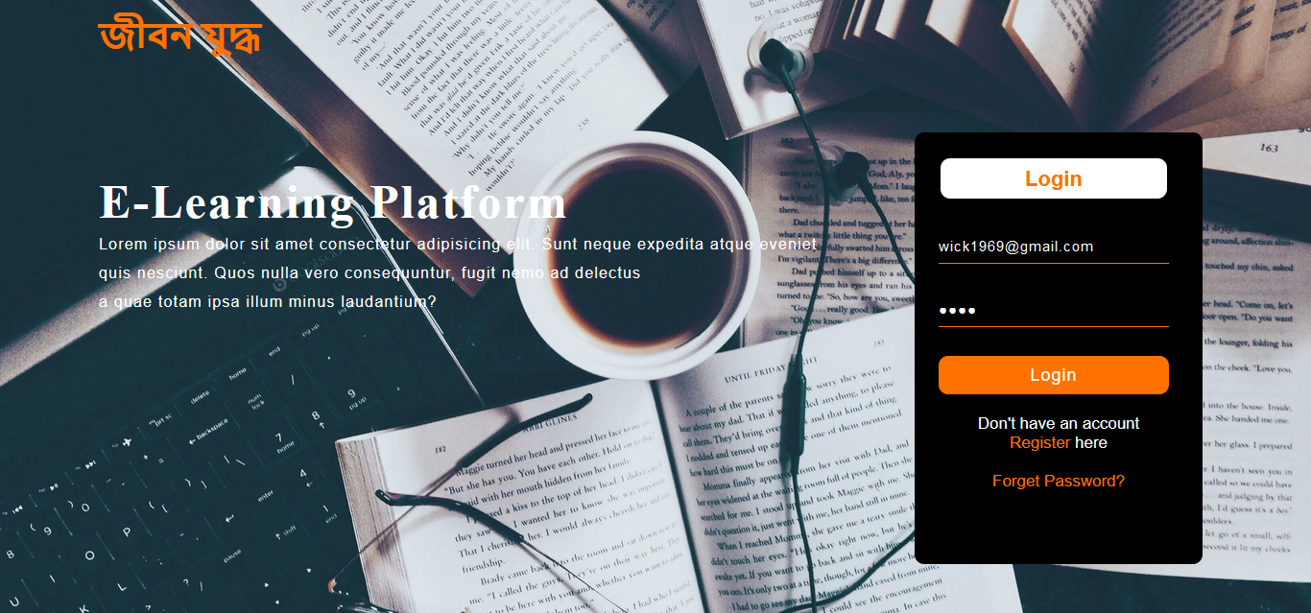

Slide 14
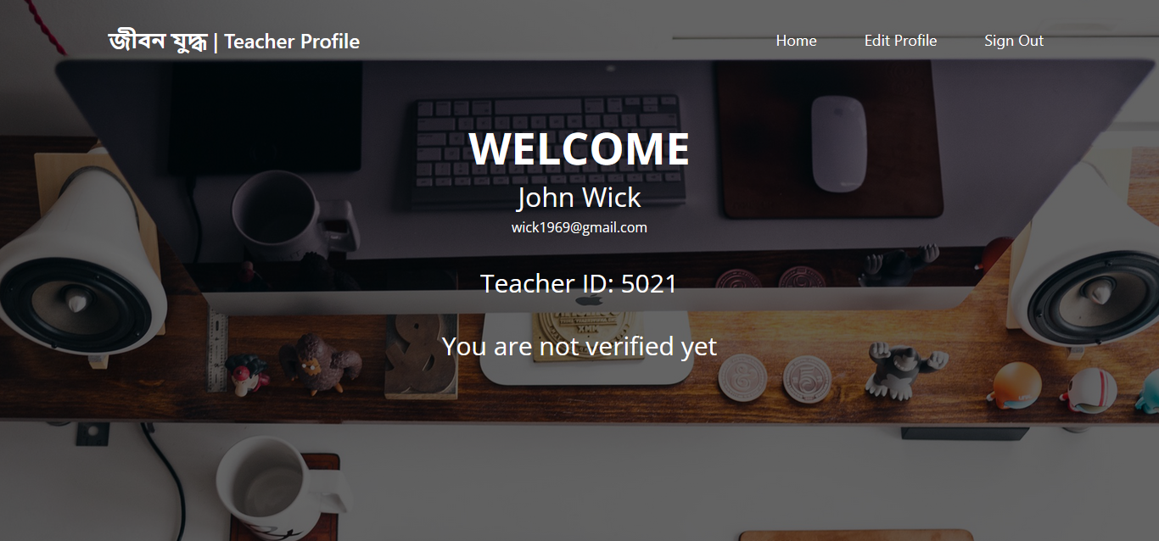

Slide 15
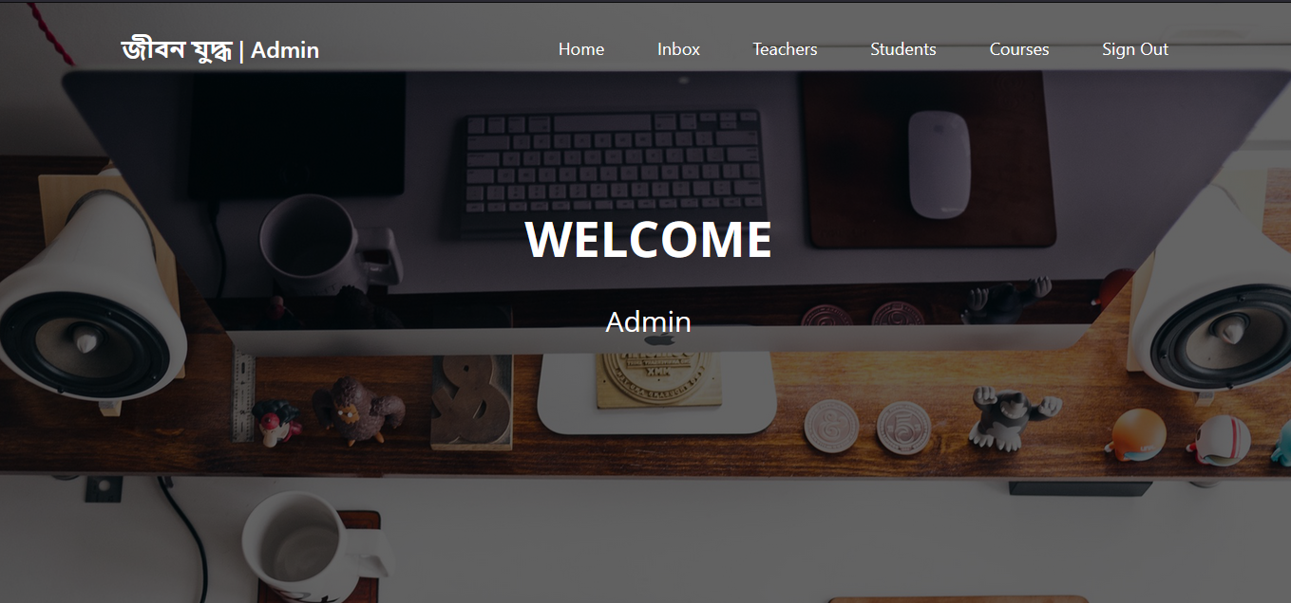

Slide 16
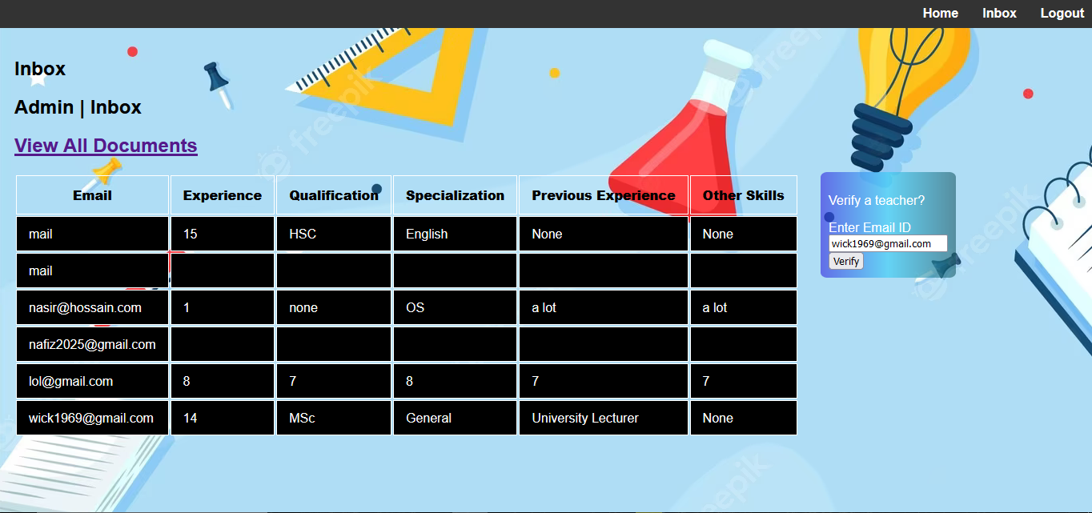

Slide 17
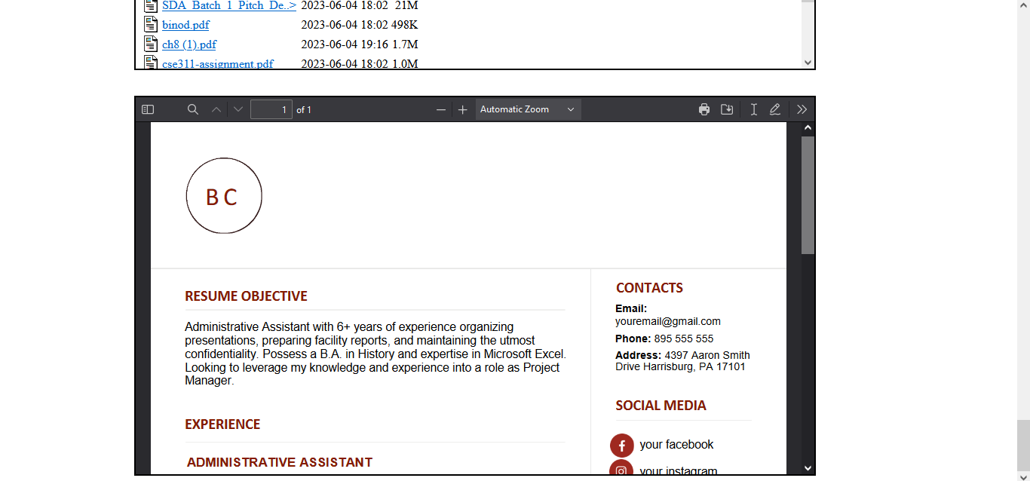

Slide 18


Slide 19
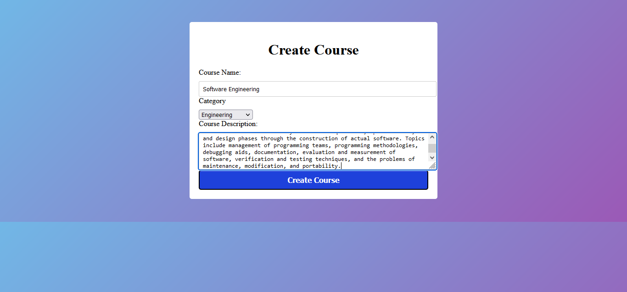

Slide 20
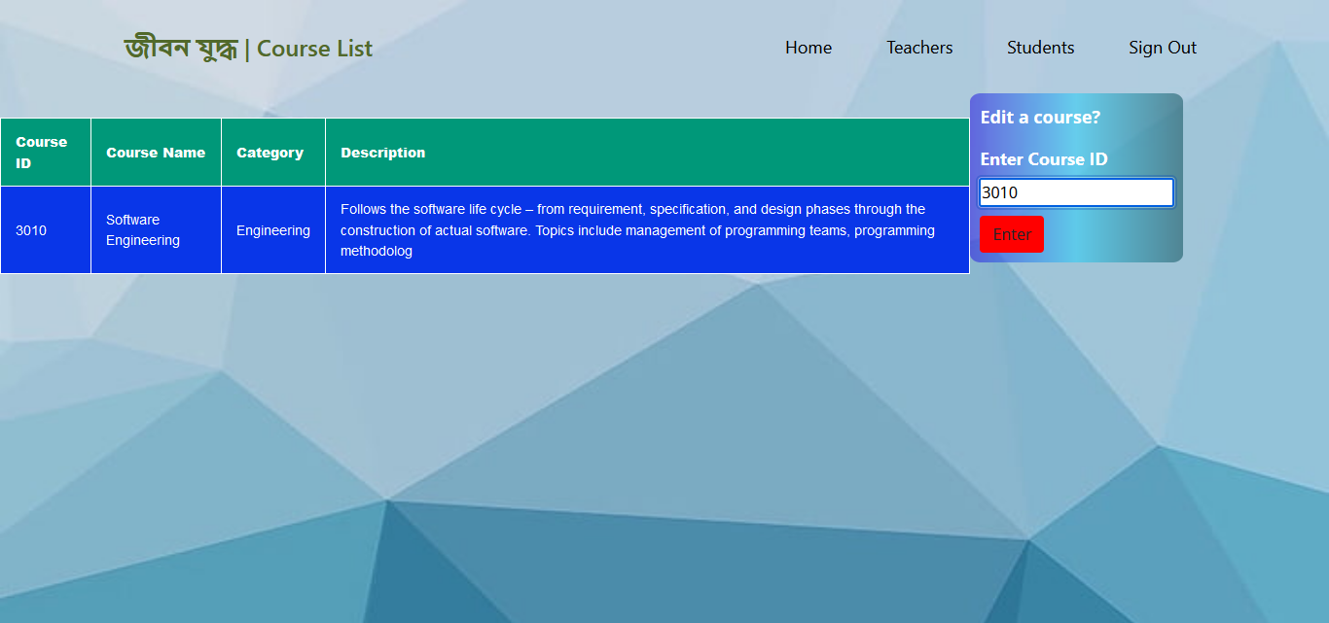

Slide 21
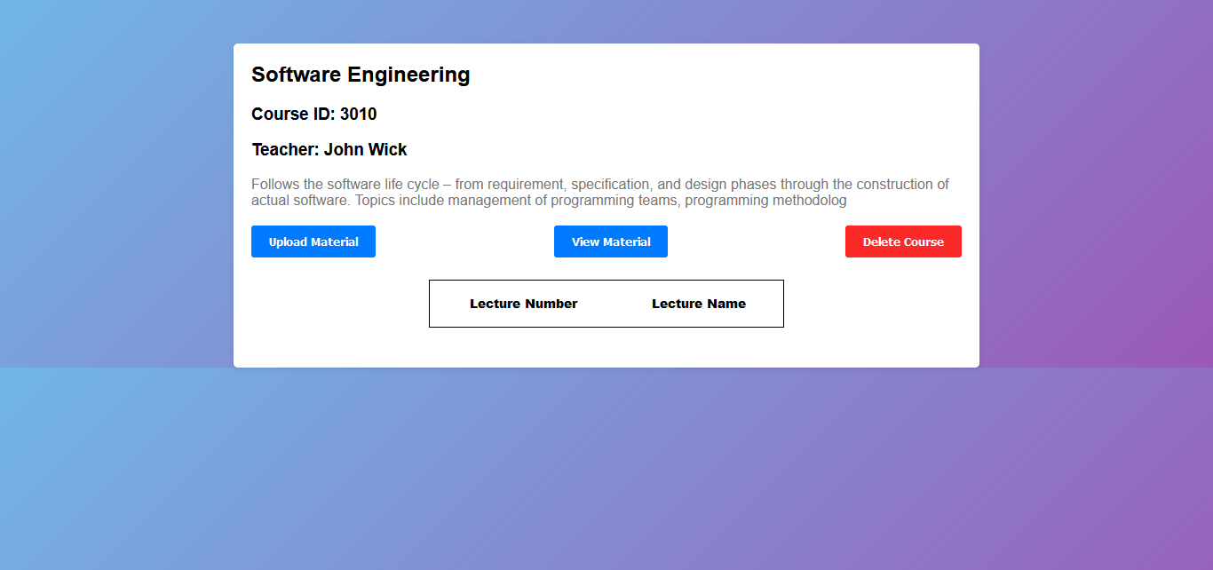

Slide 22
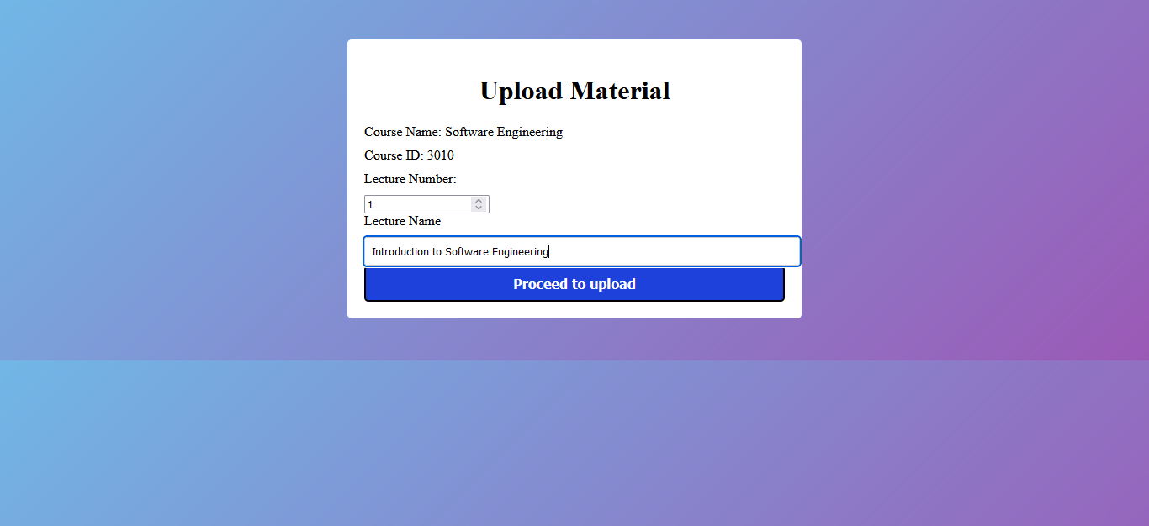

Slide 23
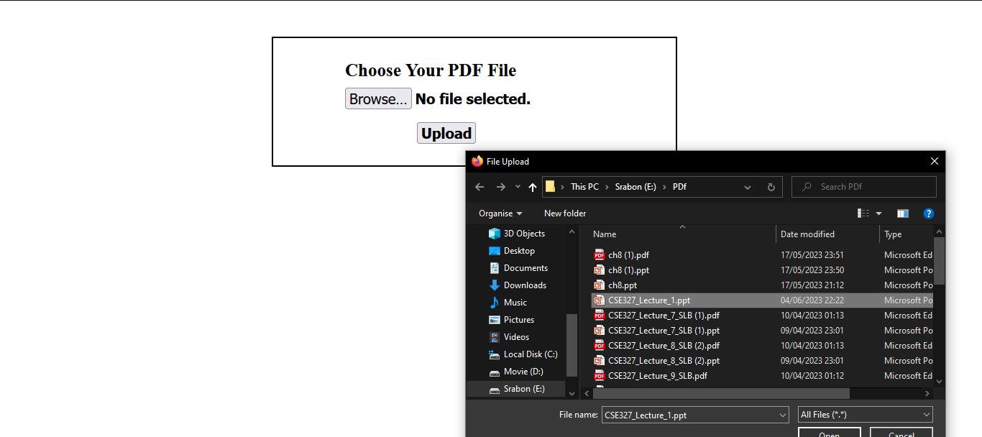

Slide 24
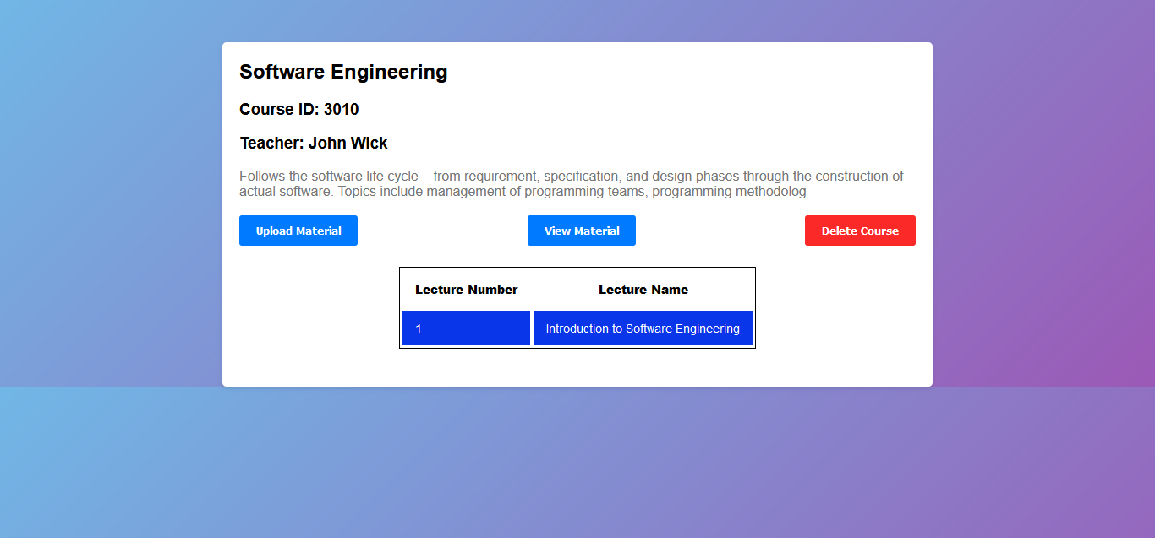

Slide 25
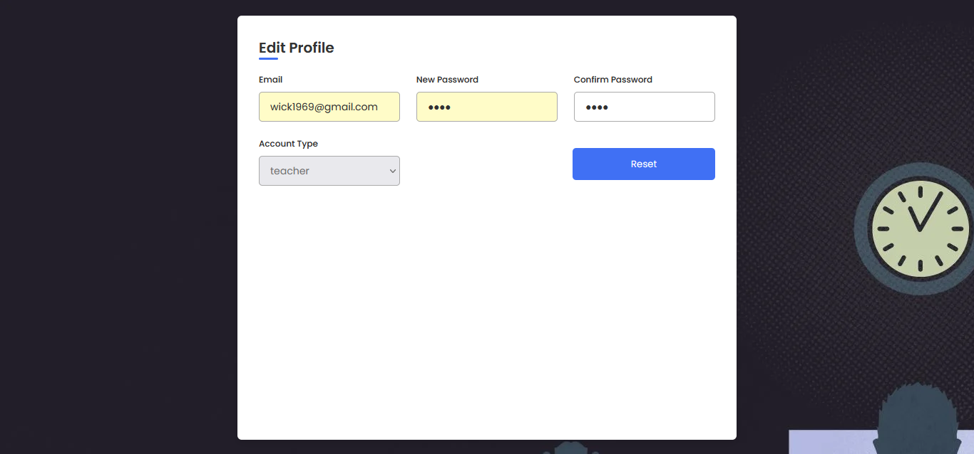

Slide 26
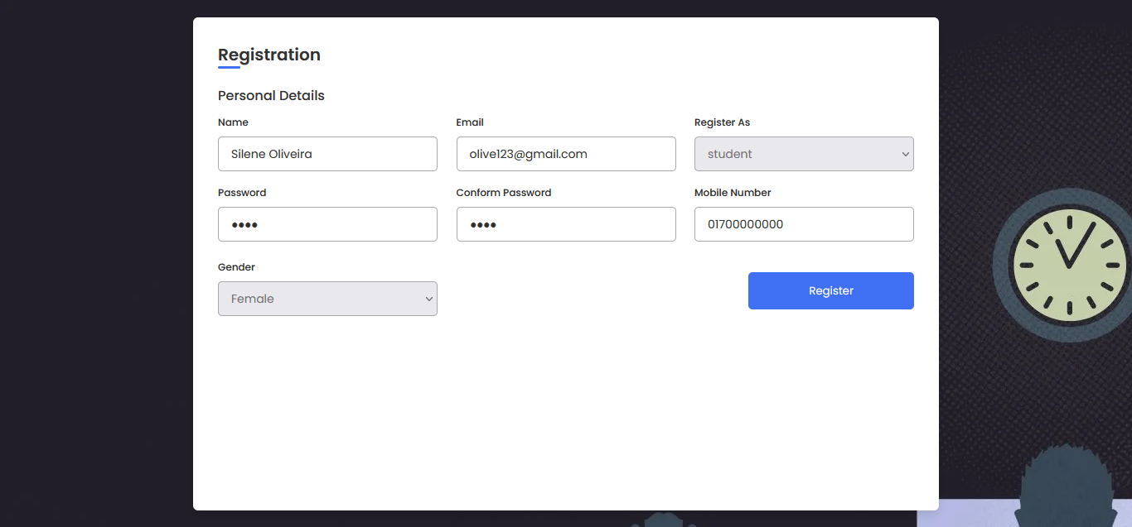

Slide 27
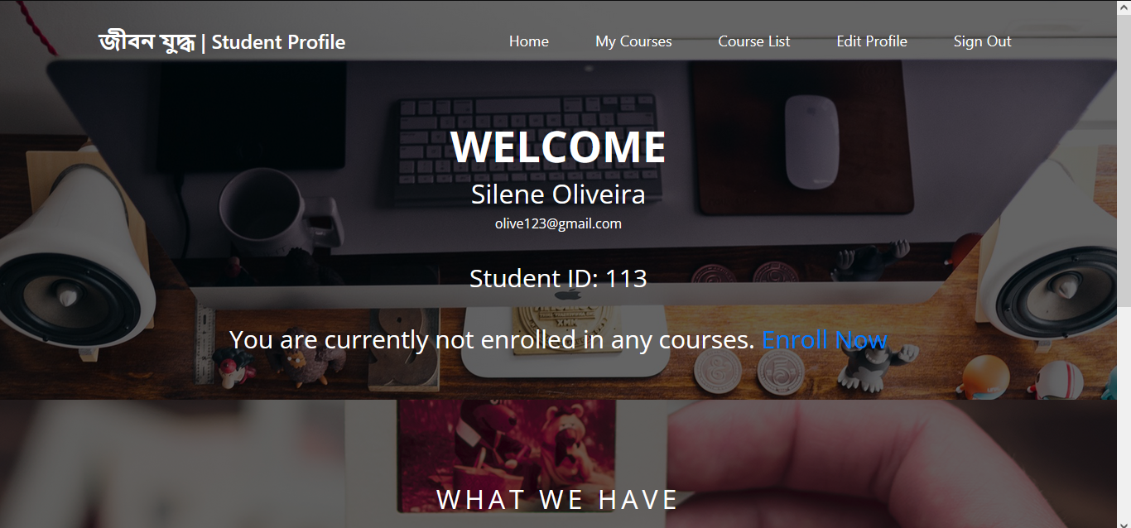
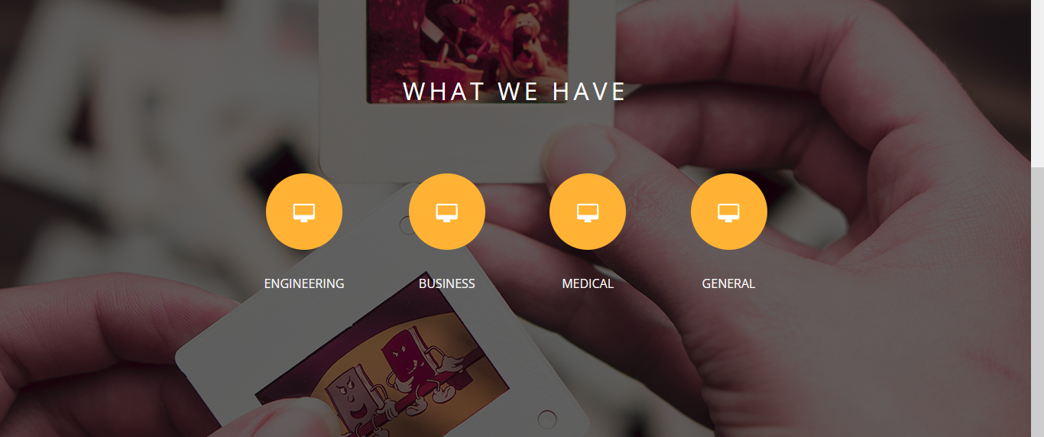

Slide 28
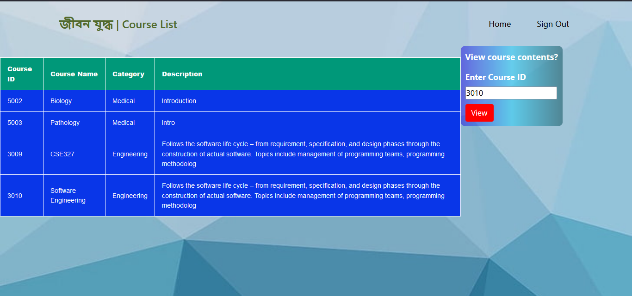

Slide 29
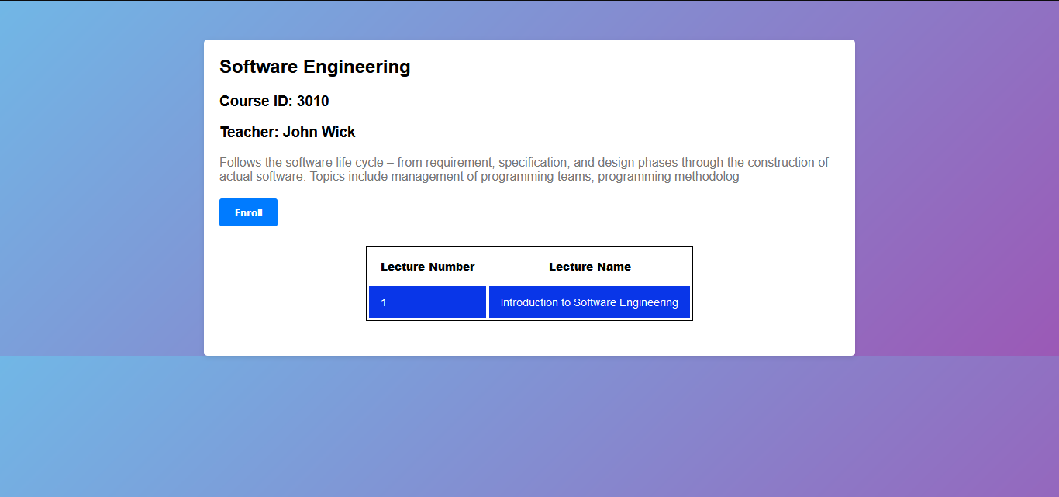

Slide 30
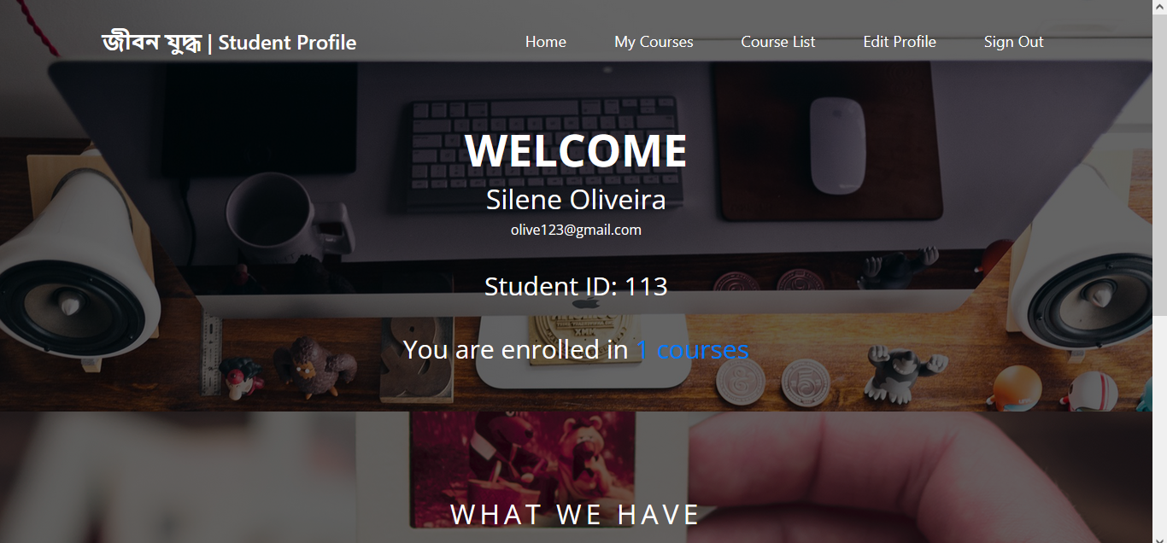

Slide 31
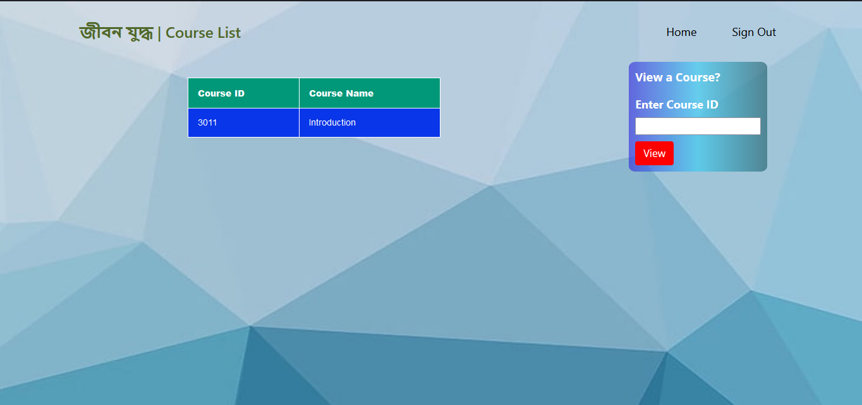

Slide 32
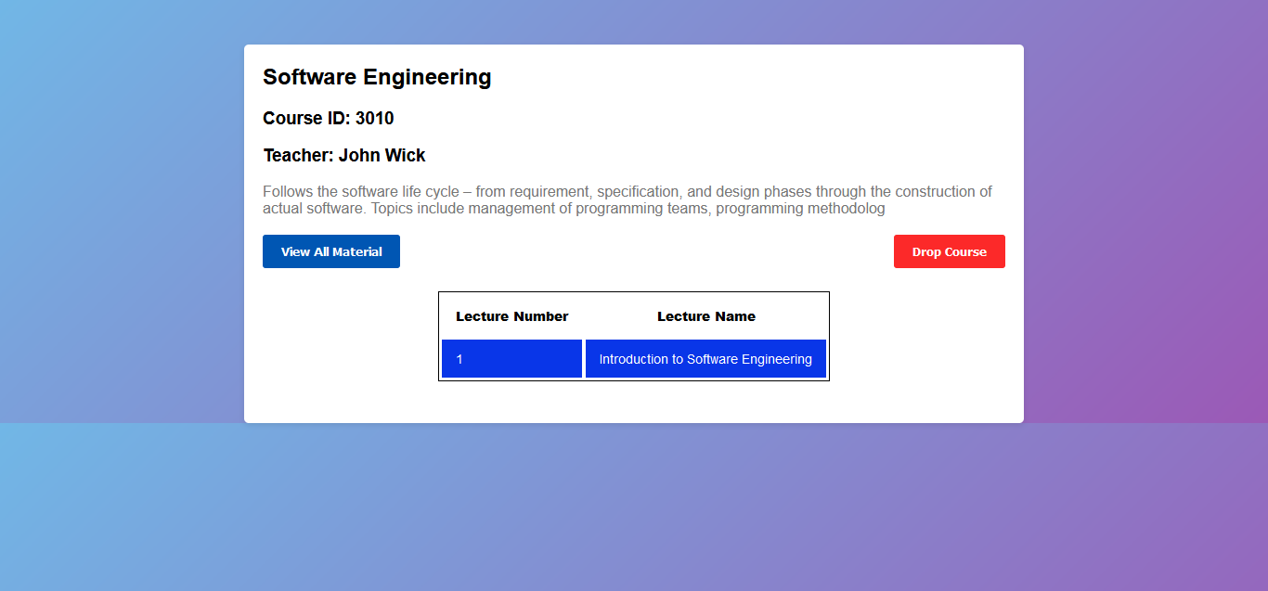

Slide 33
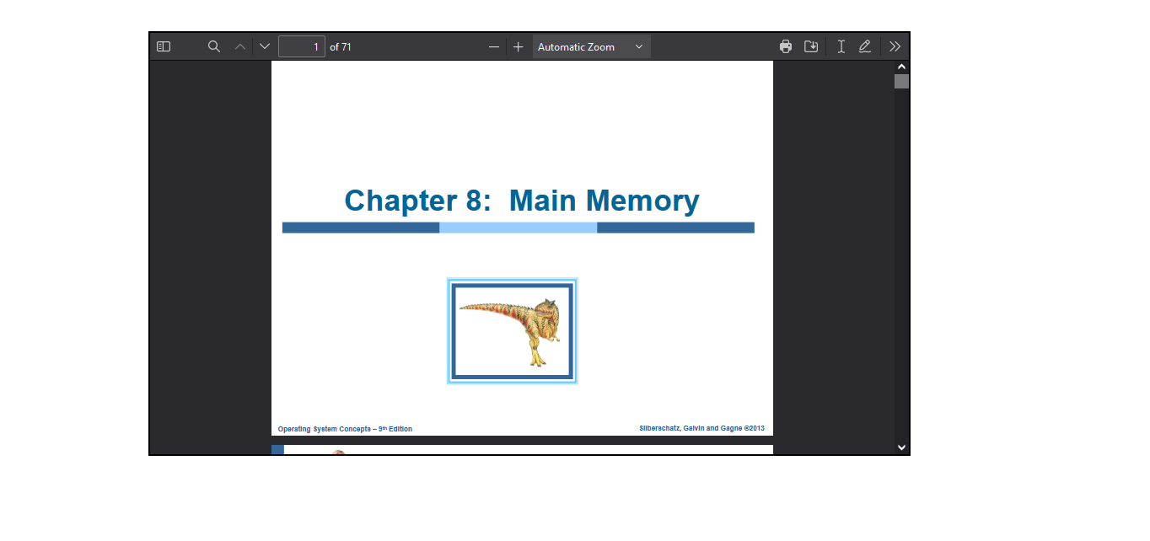

Slide 34
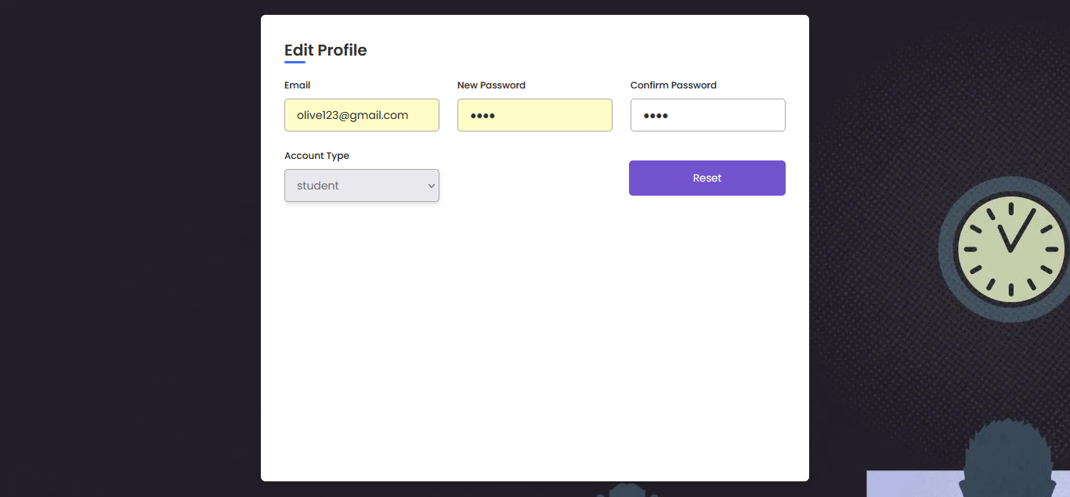

Slide 35


Slide 36


Slide 37
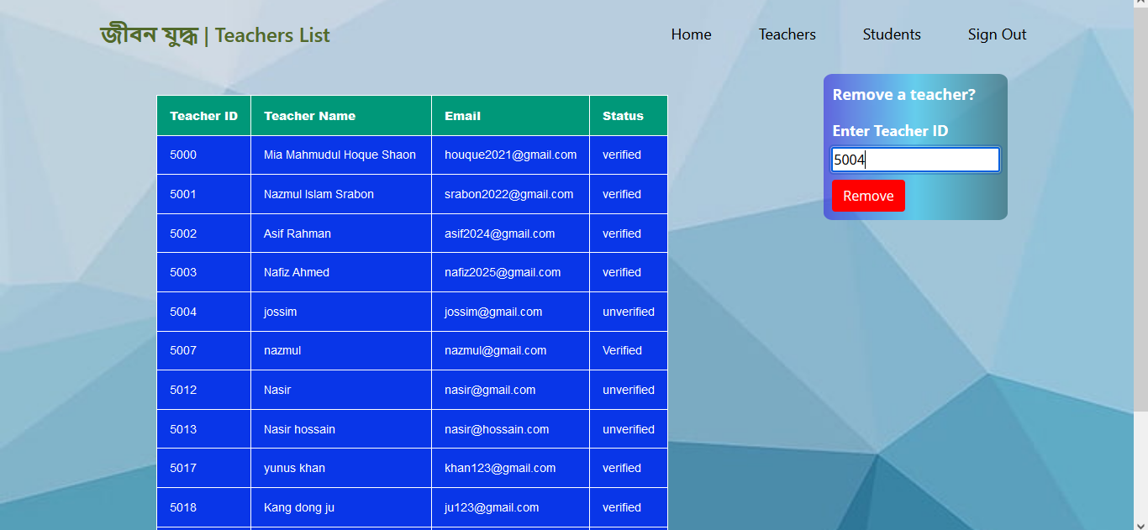

Slide 38
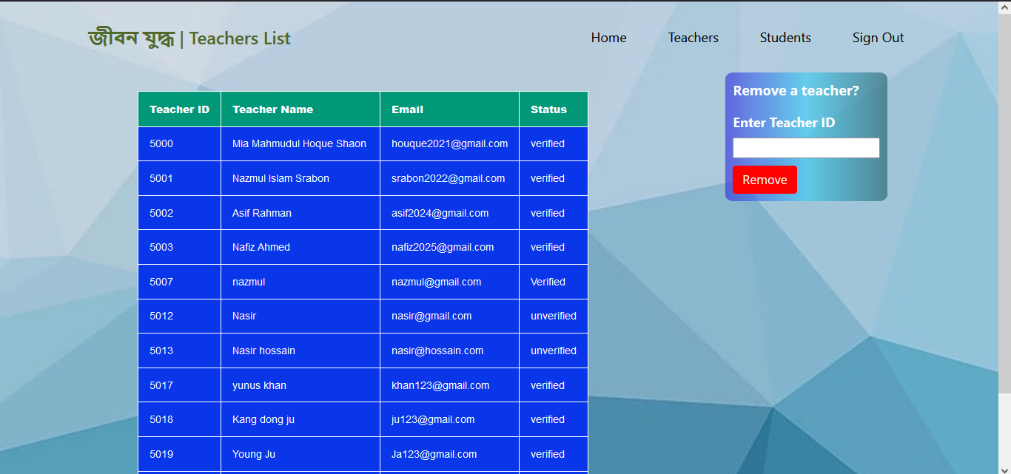

Slide 39
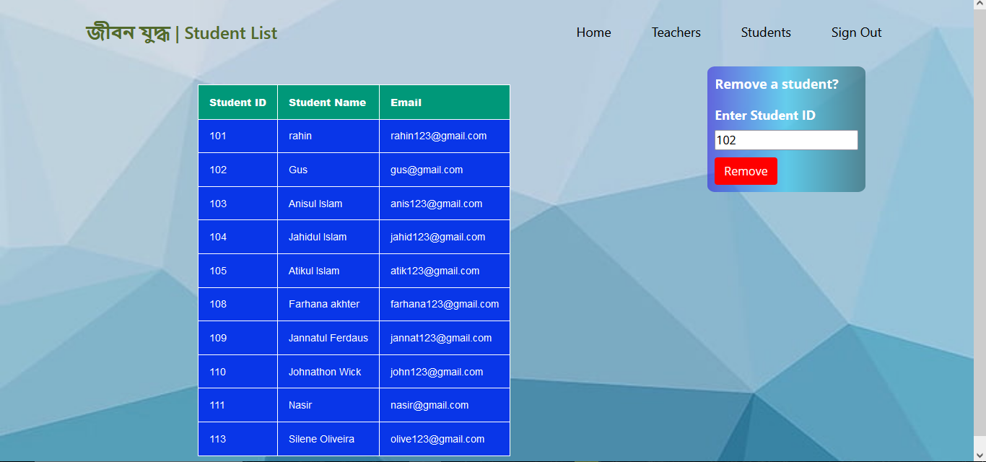

Slide 40
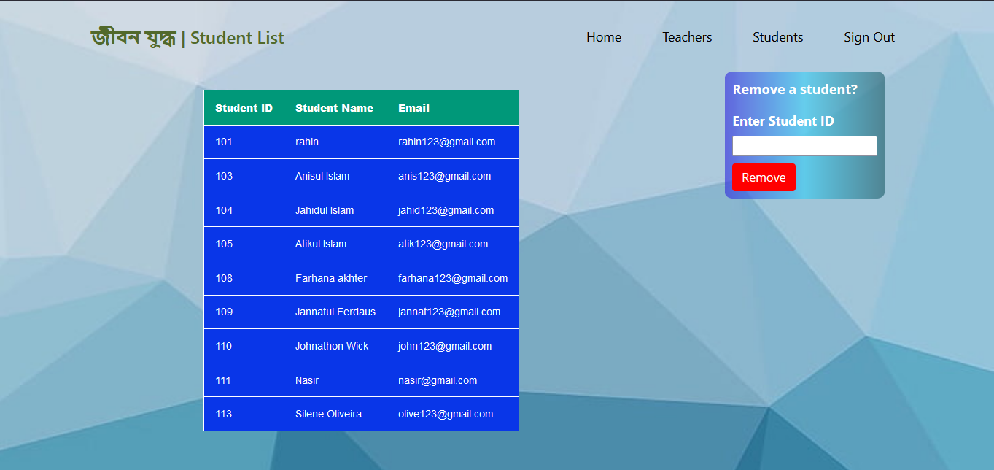

Slide 41
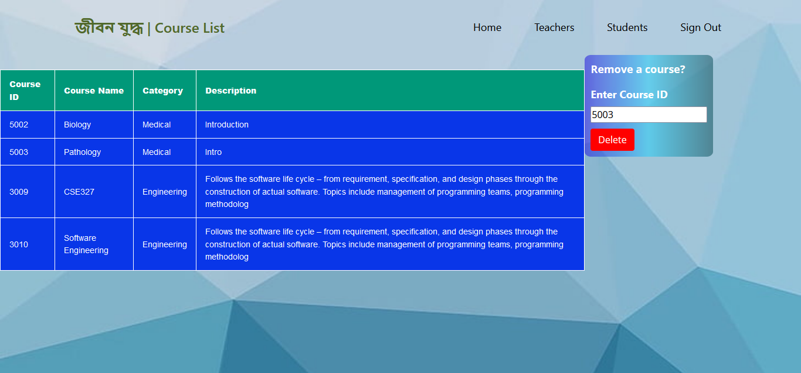

Slide 42
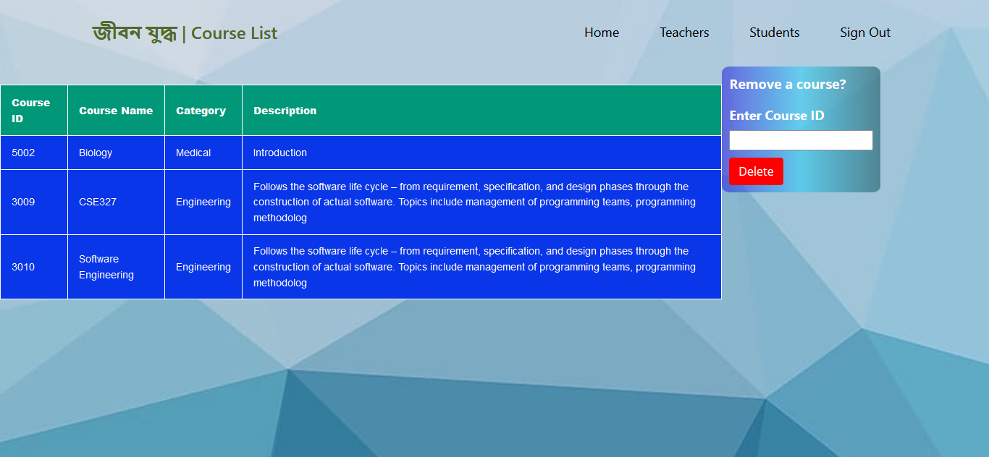

Slide 43
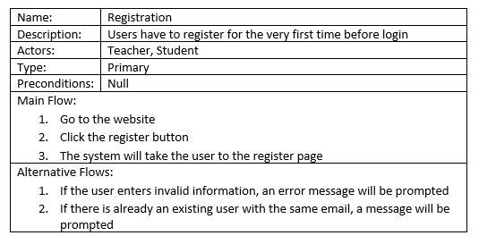
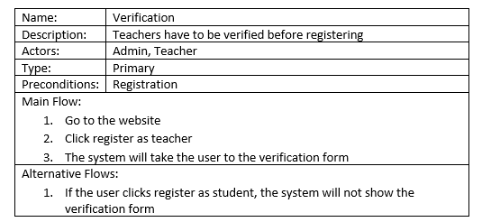
Use Cases

Slide 44
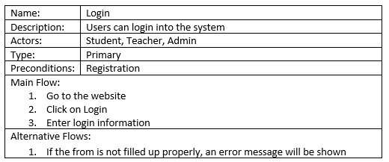
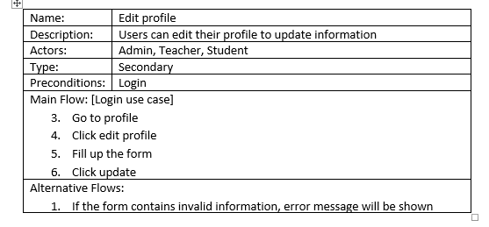
Use Cases

Slide 45
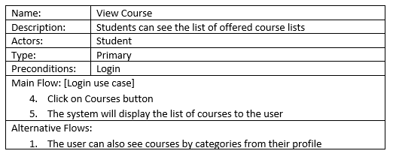
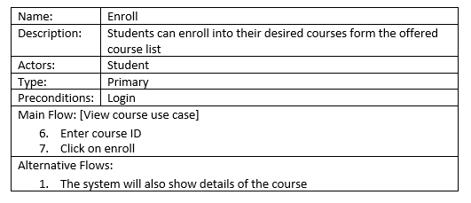
Use Cases

Slide 46
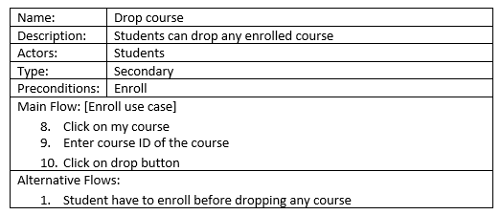
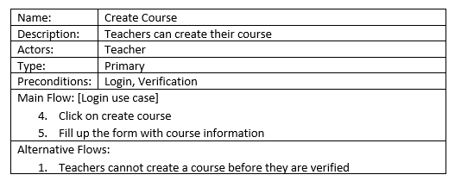
Use Cases

Slide 47
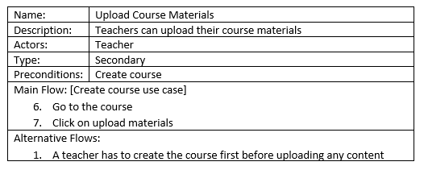
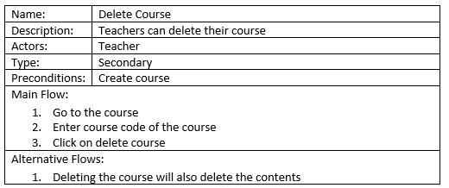
Use Cases

Slide 48
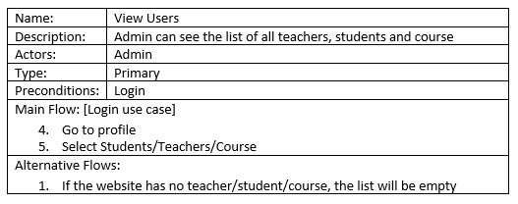
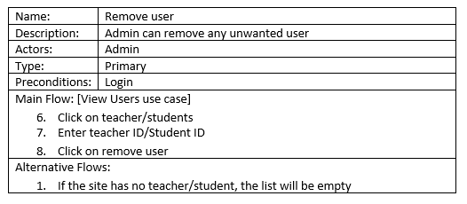
Use Cases

Slide 49
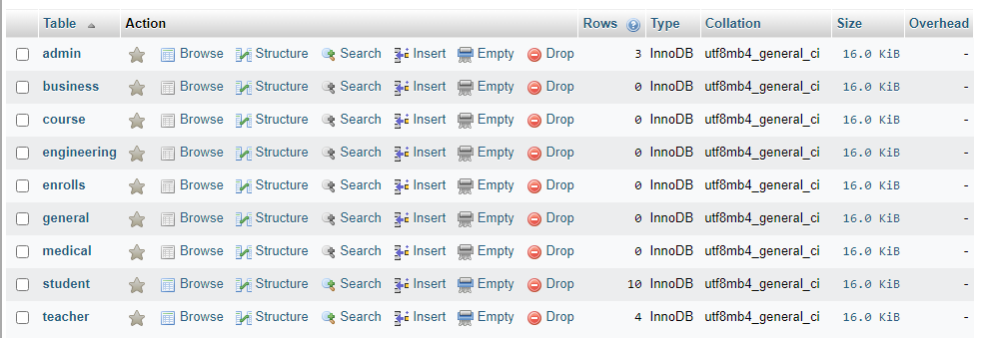
Database

Slide 50
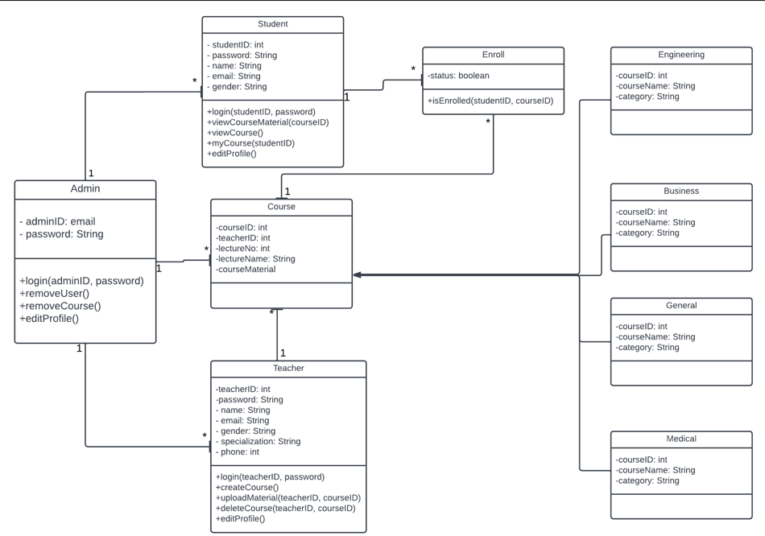
Class Diagram

Slide 51
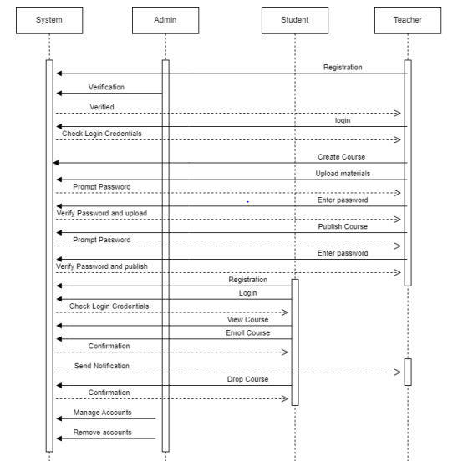
Sequential Diagram

Slide 52
Thank You!

